Slide 1
Introduction to T-test

Slide 2
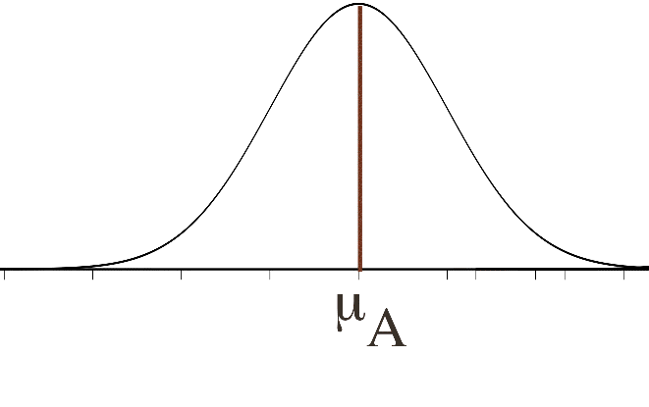
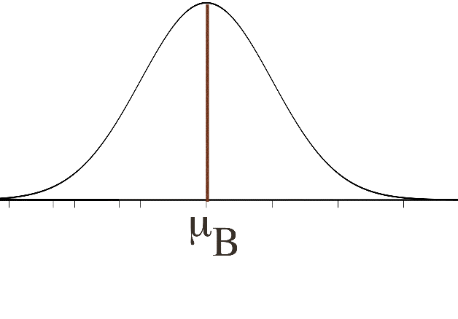

Pair Programming Type A Type B

Slide 3
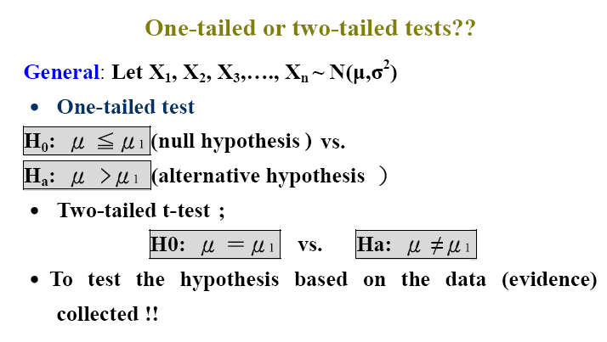

Slide 4
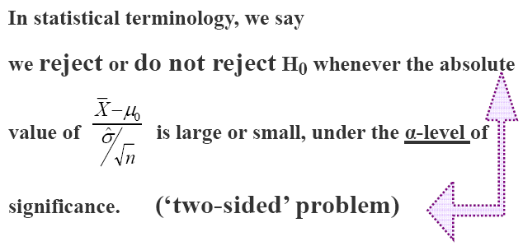

Slide 5
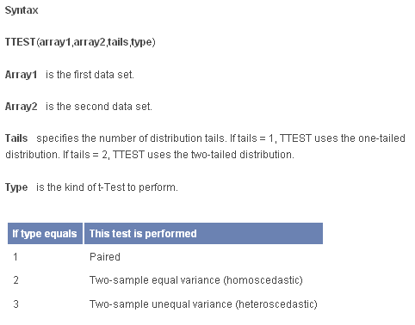
http://office.microsoft.com/en-us/excel/HP052093251033.aspx

Slide 6
